Slide 1
Operator Precedence and Associativity in C

Slide 2
Operator Precedence
Operator precedence determines which operator is performed first in an expression with more than one operators with different precedence.
For example: Solve
10 + 20 * 30

Slide 3
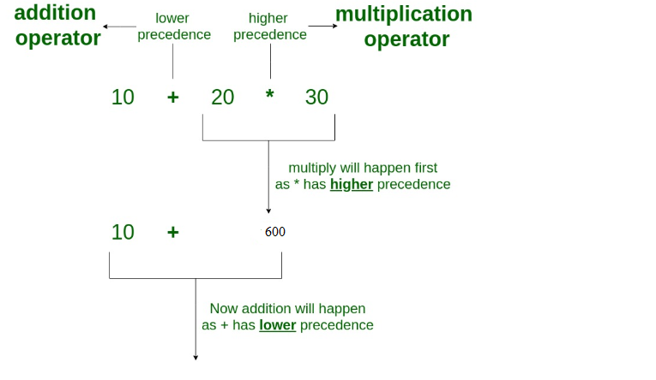
10 + 20 * 30 is calculated as 10 + (20 * 30) and not as (10 + 20) * 30

Slide 4
Operators Associativity
Operators Associativity is used when two operators of same precedence appear in an expression. Associativity can be either Left to Right or Right to Left.
For example: ‘*’ and ‘/’ have same precedence and their associativity is Left to Right, so the expression “100 / 10 * 10” is treated as “(100 / 10) * 10”.

Slide 5
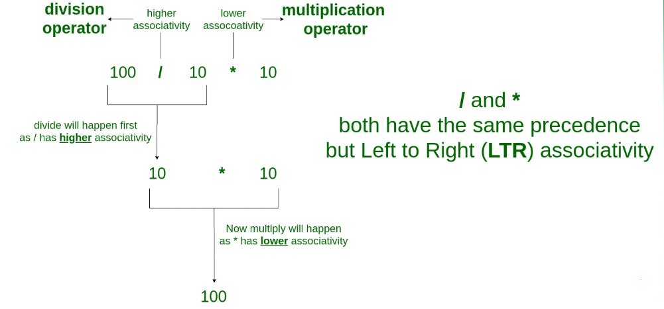
Operators Precedence and Associativity are two characteristics of operators that determine the evaluation order of sub-expressions in absence of brackets

Slide 6
Example
Solve
3 * 8 / 4 % 4 * 5

Slide 7
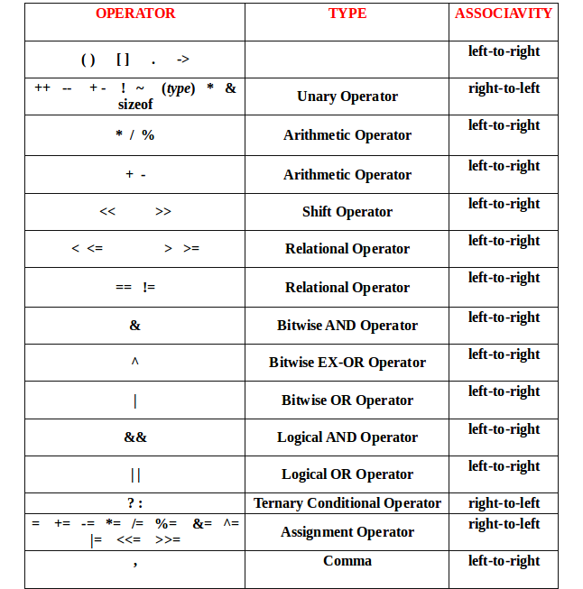
Precedence and Associativity
Highest Precedence

Slide 8
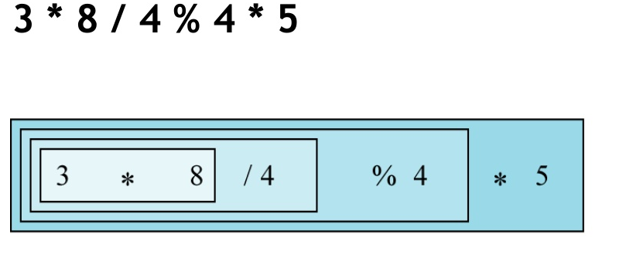
Left Associativity

Slide 9
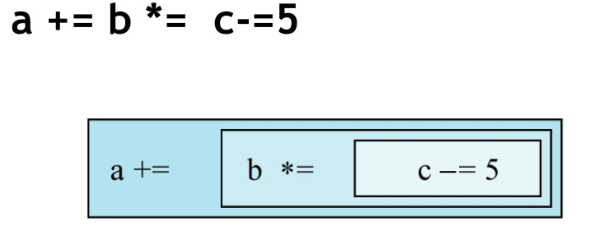
Right Associativity

Slide 10
Examples
Solve
10 – 3 % 8 + 6 / 4
17 – 8/4 *2 + 3 - ++5
Notes:
8
10

